Slide 1
INV4904 -CCAE Upgrade – Solution Options July 2020

Slide 2
INV4904- Credit and Collections Analytical Engine (CCAE) – Upgrade : Overview
INV4904 – Drivers
INV4904 – Key Requirements
Performance
Application , DB Issues
Long running queries
Storage
Lack of sufficient storage space
Servers
Operating on unsupported / near EOL servers
Outdated SQL DB
Software
Upgrade OS
Refresh the underlying hardware to be on supported platform
Upgrade SQL DB
Move to stable and latest version of SQL Server
Enhance DB performance
Stabilization and Support
Stabilize current service to move service to NG I/O
Refine the existing DB design for enhanced performance
INV4904 – Progress so far
INV4904- Original Solution
StartUp / Requirements
Design/ DXC Engagement initiated
Major Incident / P2 in current Application
Capacity constraints at DXC/ Analyze move to Azure
Capacity Issues at DXC
DXC SQR – Rejected by NG Commercials
EA advise to stabilize service on-premise
Work on on-premise solution with one server at a time(Design approved)
Tactical Solution to stabilize the existing setup
‘Lift and Shift’ model for application upgrade
On premise solution with parallel reconstruction of application
No architectural changes
Approved by ARB (CSA) as on Oct 2019
Delivery timelines ~ 8 months
Final Design approved in May 2020
Sept 2019
March 2020
Now
Oct 2019
Nov 2019
Dec ‘19 –Feb ‘20
April 2020
May 2020

Slide 3
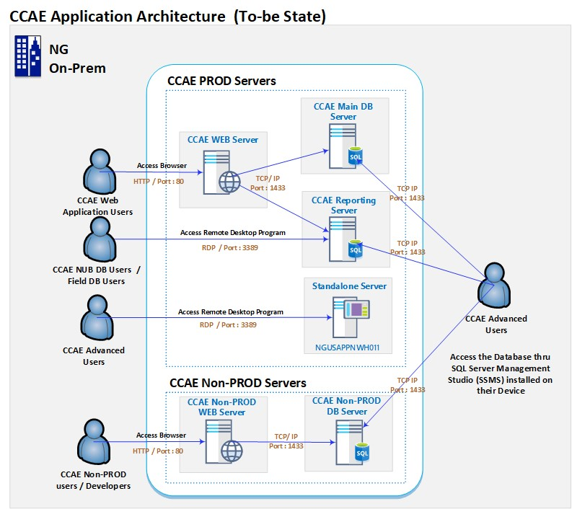
Credit and Collections Analytical Engine (CCAE) Upgrade : Solution Approach : On-Premise (DXC)
ARB Approved Solution :On-premise Solution
Continue with Original Solution : On-premise upgrade
6 Months Time to Deliver
$1.2 Mn Project Cost
↑20% Incremental RTB
-0% Scalability
N/A Security (Partly addressed)
6 Months
~$1.2 Mn
Impacts | Details
Hosting Platform | Remain on-premise at DXC data centers
CCAE | Minimal changes to DB design
CSS /CRS | Automate data download process via ESP
Note :
ARB Approved Solution (CSA/LTM)
Work in progress with 1 new Non-Prod server
Delayed start of server build due to capacity limitations at DXC
Challenges
Risks
Capacity constraints at DXC datacenters
Current architecture may pose performance and security issues in the longer run
On-Premise Upgrade

Slide 4
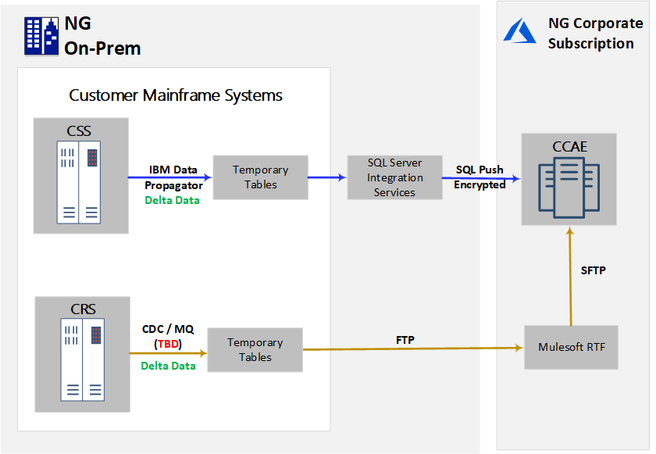
Credit and Collections Analytical Engine (CCAE) Upgrade : Solution Approach - Move to Azure
Rehosting to Azure
Compared to on-premise solution
↑100% Scalability
↑100% Secure
↓80% Data loads
↑150% Time to Deliver
↑300% Project Costs
↑120% RTB
18 Months
~$4.5 Mn
Impacts | Details
Hosting Platform | Move all servers to Cloud Platform /Azure
CCAE | Rearchitect to enable delta data loads from Customer Systems
CSS | Leverage delta capture / CDC mechanism (GBE solution) to provision for additional tables
CRS | Check for CDC/ MQ to capture delta loads (Solution to be determined)
Middleware | Need for middleware for transferring data from CRS
Mainframe Capacity | Need for additional capacity at Mainframe (CSS) to support solution
Other Systems | Applications/Systems from GBE solution may be impacted
Challenges
Needs extensive changes to CCAE architecture
Any unknowns within CCAE
Risks
Multiple system impact
Check for alignment with enterprise strategy
Azure Solution

Slide 5
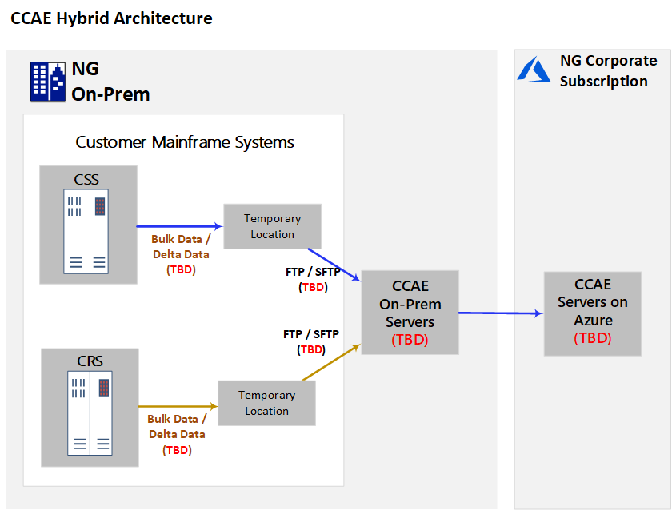
Credit and Collections Analytical Engine (CCAE) Upgrade : Solution Approach - Hybrid
Hybrid Option – On-Premise + Azure
Hybrid option for shortest delivery compared to on-premise solution
↑30% Scalability
0% Reduced Data loads
↑50% Time to Deliver
↑50% Project Costs
↑20-40% RTB Costs
9 Months
~$1.8 Mn
Impacts | Details
Hosting Platform | DXC + Azure (Multiple feasible / Fastest Solution : DB server (DXC) , Web+ App (Azure) / FTP Bulk data
CCAE | CCAE landscape needs to be revisited for optimal performance
CSS/CRS** | No change in current process if SFTP and delta data loads are NOT enabled apart from automating data loads via ESP
Middleware** | Need for middleware for transferring data from CSS/CRS if needed to have SFTP file transfers enabled
** - Considerable impacts to CRS/CSS if designed to follow delta data capture mechanism
Challenges
Risks
Latency issues (if DB and Web different hosting env.)
Capacity issues for on-premise servers
Hybrid Solution
Note:
With Hybrid solution, multiple design options are feasible
Details listed are for shortest path to delivery ( Customer Systems-> Bulk data transfer -> FTP-> CCAE DB On-premise / Web , App on Azure )

Slide 6
Credit and Collections Analytical Engine (CCAE) Upgrade :Solution Approach - Summary
Sr | Hosting Option | Details | Assumptions | Points to consider | Impact** | Risk Rating | Complexity | Timeline** | Total Cost**
1 | On-premise | On-premise (stay at DXC) with parallel application upgrade | Recommended capacity is available at DXC to reconstruct application in parallel along with setup of lower environments | Tactical Non Scalable solution Performance issues similar to current , may prevail in the longer run | Low | Low | Low | 6 Months | ~$1.2M
2 | Azure | Move CCAE hosting env. completely to Azure | Delta Data Capture : Ability to leverage GBE solution for CSS ; Similar solution using MQ/ Middleware to be worked for CRS | Complex solution with extensive changes to CCAE architecture | High | Med-High | High | ~ 18 Months | ~$4.5M
3 | On-premise + Azure | Redesign CCAE server landscape : Multiple design options feasible with Hybrid | Recommended capacity is available at DXC for servers | Probable latency issues with 2 different data centers Capacity constraints for on-premise servers Needs revision of CCAE architecture | Low -Med | Low | Medium | ~9 Months | ~$1.8M
Note:
**Indicative total cost of delivery based on preliminary analysis , high level solution approach and impact to other systems
Timelines indicated are for best case scenario /shortest time to deliver , for the approach listed
Solution approach/options NOT reviewed by Enterprise and Information architect group (07/16)

